Slide 1
Analyzing the Impact of COVID-19 Vaccination Rates on Case Trends in Maryland
Torrodjae Somerville
CTEC 128
12/4/2024

Slide 2
Problem Statement
The COVID-19 pandemic in the past has significantly impacted public health in Maryland, with vaccination campaigns playing a critical role in controlling the virus. However, questions remain about the relationship between vaccination rates and case numbers across the state. This study seeks to analyze these trends to uncover patterns, assess disparities, and provide insights into the effectiveness of vaccination efforts in reducing COVID-19 cases.
And answering the questions of anti-vaxers who pose against the implementation and use of the vaccine by finding the relationship between them.

Slide 3
Research Questions (Statistical)
What is the relationship between COVID-19 vaccination rates and the number of COVID-19 cases in Maryland counties over time?
What trends can be observed in the daily increase of COVID-19 cases over time, and how do they relate to the rollout of vaccinations?
What is the data trend of vaccinations over time in comparison to the amounts of new cases per day.

Slide 4
About the Dataset and Where it Came From
Where’d I get my data?
COVID-19 Vaccinations in the United States,County : The CDC had over 1.9m rows
MD COVID-19 - Cases by County : Maryland Open Data.gov
Columns Used?
Date: Tracks the time progression of vaccination and case data.
Recip_County: Identifies data by county within Maryland.
Administered_Dose1_Pop_Pct: Percentage of the population that received the first dose of the vaccine.
Series_Complete_Pop_Pct: Percentage of the population that completed their vaccination series.
COVID-19 Cases: Daily or cumulative COVID-19 case numbers (from the second dataset).
Metro_status: Identifies urban, suburban, or rural areas (if analyzing trends by region).

Slide 5
Data Cleanup
Columns that won’t be used:
FIPS: Federal Information Processing Standard code, not needed for this analysis.
MMWR_week: Epidemiological week data, unnecessary for your focus on vaccination trends.
Completeness_pct: Percentage completeness of reporting, not directly tied to the research questions.
Administered_Dose1_Recip_5Plus, Administered_Dose1_Recip_12Plus, Administered_Dose1_Recip_18Plus: Redundant since you are using broader population-level vaccination percentages.
Second_Booster_50Plus, Second_Booster_65Plus: Specific data not part of your research focus.
Data Cleanup Methods
Filtered Data by Location:
Retained only rows for Maryland counties to align with the study's geographical focus.
Removed Irrelevant Columns:
Excluded columns unrelated to the research questions, such as codes (FIPS), week identifiers (MMWR_week), and redundant demographic breakdowns.
Standardized Date Format:
Ensured the date column followed a consistent format to facilitate time-based analysis. (and setting date restriction to look at the correct data.)
Excluded Incomplete Data:
Removed rows with missing or incomplete entries in key columns, such as vaccination percentages or case numbers. (unknown listed counties were removed)
Simplified Population Metrics:
Focused on broad categories (e.g., total population, 65+ population) instead of granular age groups.
Validated Data Accuracy:
Cross-checked key values for anomalies or outliers, ensuring data integrity for analysis.

Slide 6
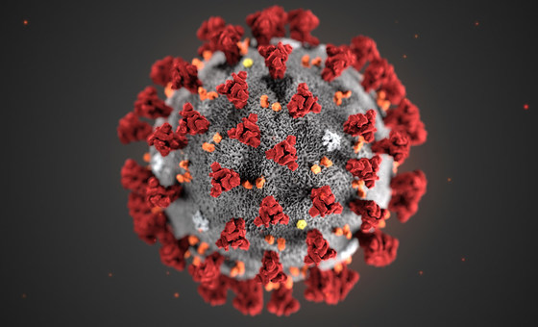
Summary of my Covid-19 Discoveries

Slide 7
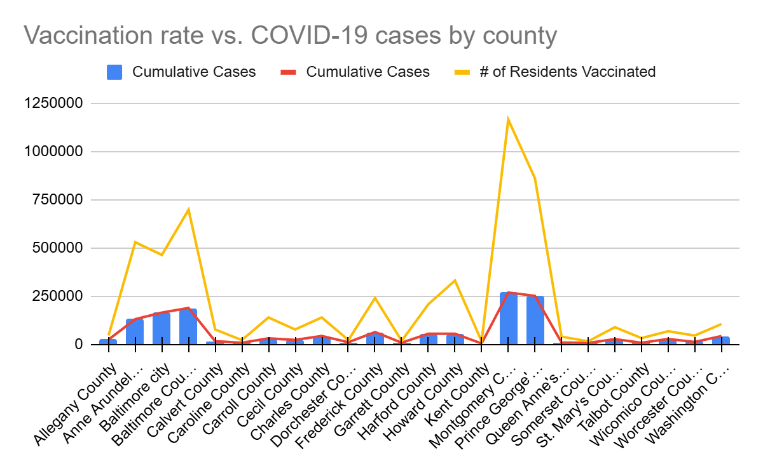
Vaccination Rate vs. COVID-19 Cases by County Chart: (Combo chart)
Purpose of the Chart:This scatter plot shows the relationship between the vaccination rate (# of people vaccinated) and the cumulative COVID-19 cases for each county in Maryland.
X-Axis:Represents the counties in Maryland, with each point corresponding to a specific county.
Y-Axis:Displays two sets of values:The vaccination rate (percentage of people vaccinated) for each county.The cumulative COVID-19 cases for each county. Both values are plotted as dots, and the position on the Y-axis indicates the level of each measure.
Key Observations:Each county is represented by two lines and a bar(one red and blue bar for the vaccination rate and one yellow for COVID-19 cases).
One thing I noticed is that that chart appears to show a correlation of where both sides appear to be right, when saying the implementing of it can really cause you to get it. As the places with more cumulative cases in the end do have higher vaccination rates.
But when looking at them in comparison the gaps in amounts of people who received the vaccine and populations of these areas the populations are much larger there sometimes 4x as much as the one next to it which plays a big role in their cumulative total. But even with that it does appear that counties with higher vaccination rates had higher cases.
(Summation was used here to find the cumulative total of all the cases)

Slide 8
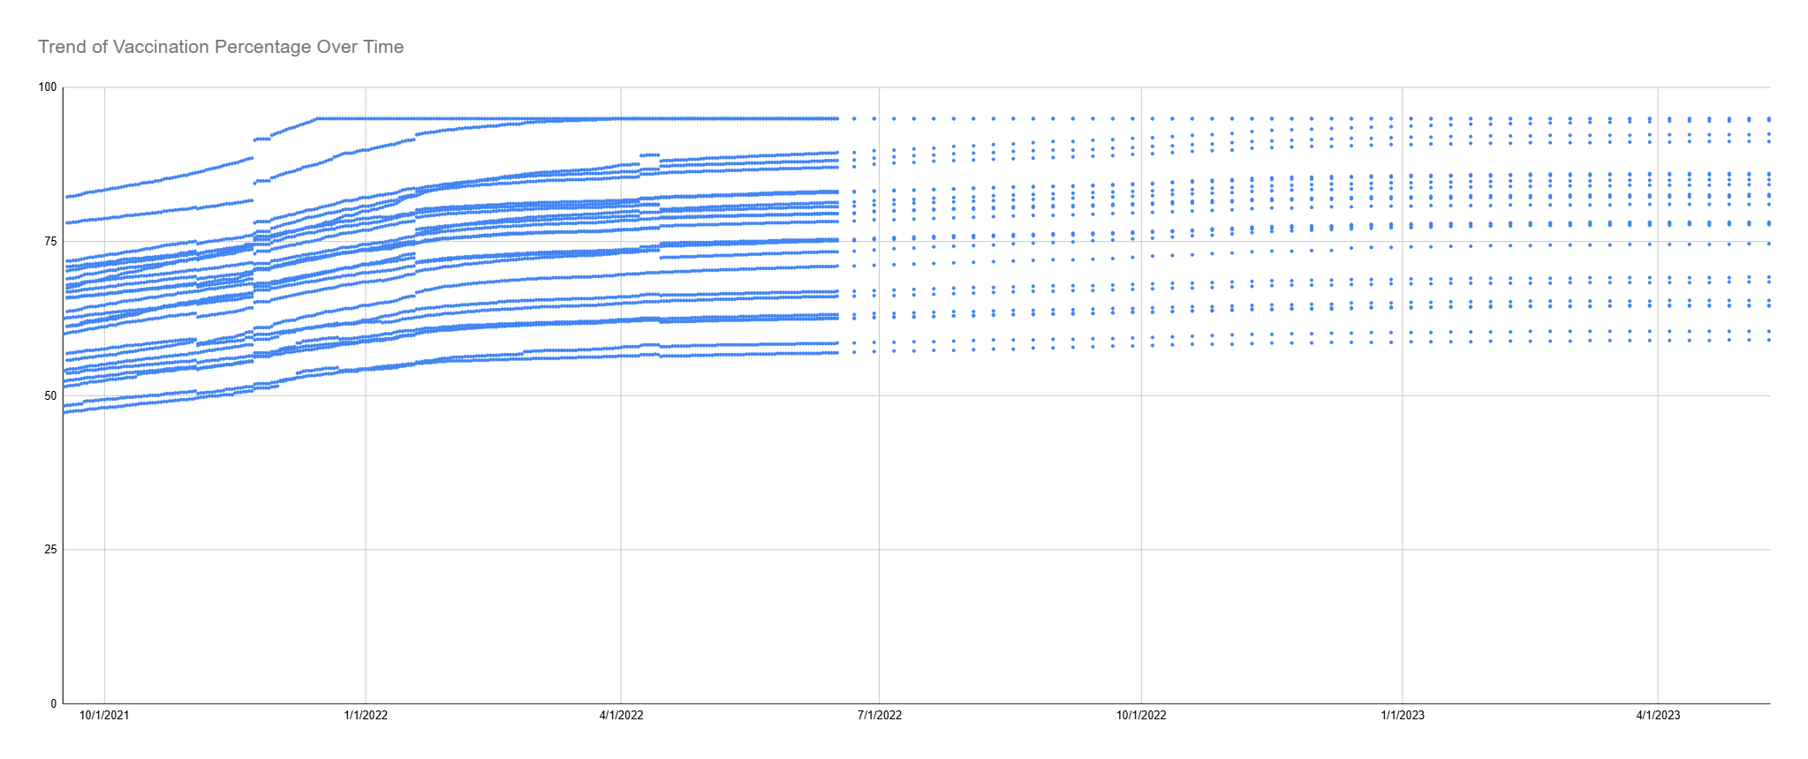
Vaccination Rate Over Time (Scatter Plot)
X-Axis: DateShows the timeline of vaccination progress (daily data).
Y-Axis: Administered Dose 1 Pop Pct (or Series Complete Pop Pct)Represents the percentage of the population that has received the first dose of the vaccine (or is fully vaccinated) across time.
Purpose:To track the trend of vaccination rates over time.To observe any major increases or plateaus in vaccination efforts.
Key ObservationsAccording to this no matter what the stipulations are the amount of people getting the vaccine in MD increased over time.
Used aggregation for the time intervals/dates to try and consolidate this massive amount of data and display the trend.

Slide 9
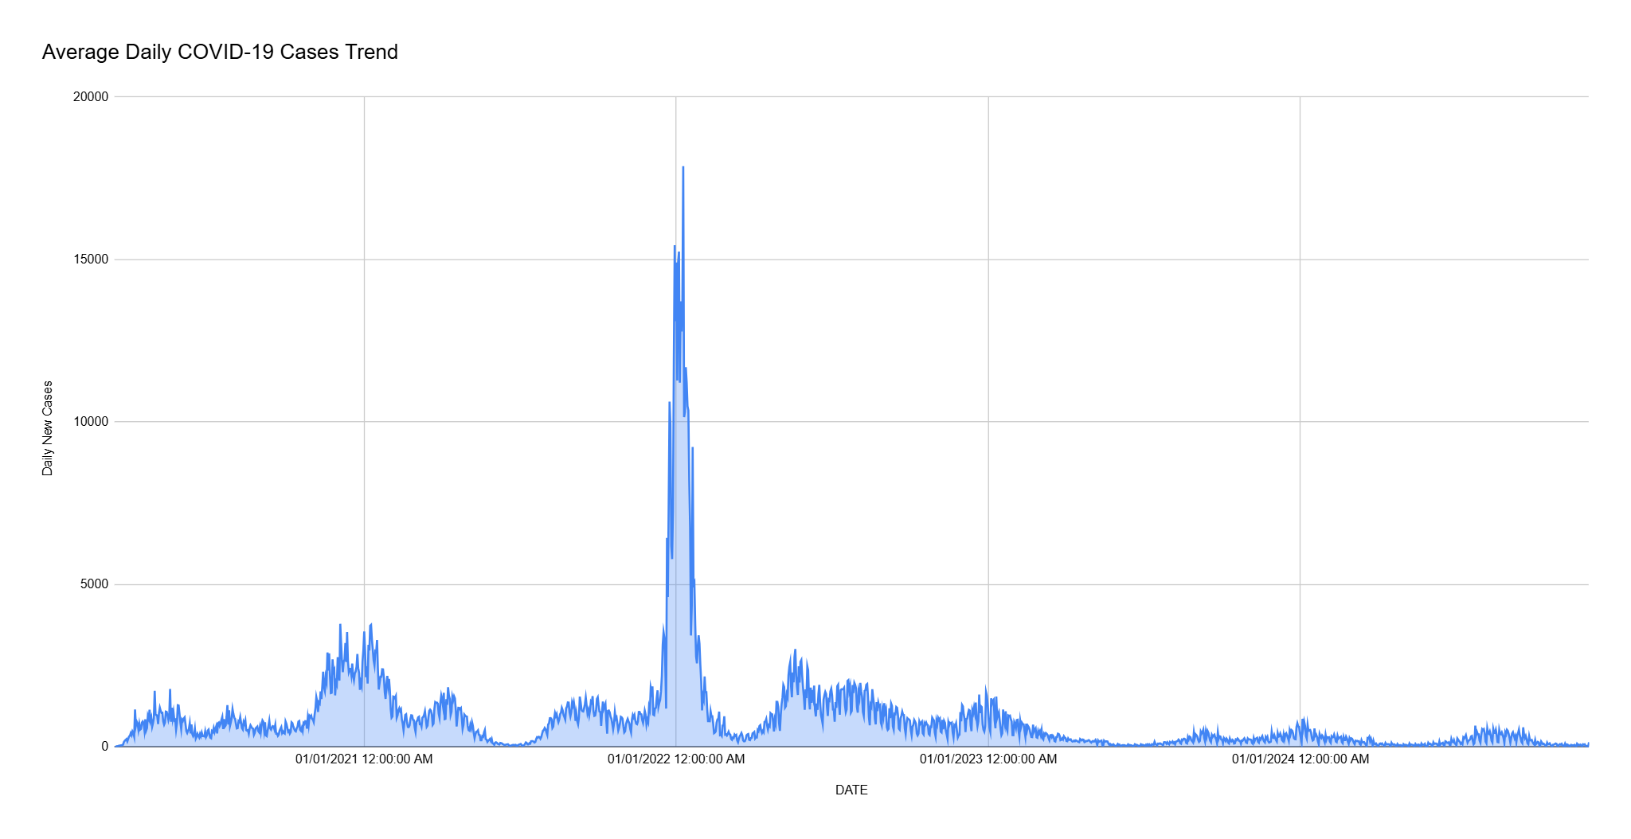
Daily COVID-19 Cases Trend (Stacked area chart)
Purpose: Tracks the daily new COVID-19 cases over time to analyze infection rate trends.
Key Observations:Initial spikes in daily cases during early stages of the pandemic.Fluctuating trends with noticeable declines after vaccine rollout phases.Steady decrease toward the present day, indicating reduced transmission.
Significance:Provides insights into how the pandemic evolved over time.Highlights the impact of public health measures and vaccination campaigns.Helps evaluate the success of efforts to control COVID-19 spread in Maryland.
Discussion Point: After the spike in Covid-19 cases and they peaked this was during the same time as when vaccinations peaked.Which is also right around the same time the FDA approved of the vaccine in late 2021 and early 2022 as more variations of it rolled out. But as the number of vaccinated people continued to climb, the cases continued to decrease showing a more direct trend.
Math formula used to make new row from data example: =AA4 - AA3 used to find the new cases change per day

Slide 10
Conclusion
What conclusions did I drawn from my exploration and analysis of the data?
Well to answer my first research question the data showed it kind of mirrored itself but there did seem to be a relationship of the higher the vaccine rate of the county, the more cases of covid they had.
The infection rate, as measured by daily new cases, shows a significant decline after widespread vaccine availability, indicating a strong correlation between vaccinations and reduced transmission.
Trends over time reflect the pandemic's trajectory, with spikes in cases followed by gradual declines corresponding to public health measures.
Which in all I believe yes with every vaccination there’s a little bit of the virus in it, which could lead to the population getting it in the short term. But based off the data showing the case trends over an extended time period, in the short term it may cause some cases but in a long run it’s worth it because as the data Daily Covid 19 Case Trend chart shows it really diminishes the virus.
Why are my findings important? How can they be used?
These findings highlight the critical role of vaccinations in controlling the spread of COVID-19.
They provide evidence to inform future public health policies and vaccination strategies, especially in mitigating future outbreaks.
The analysis can be used to communicate the importance of vaccines to the public and guide resource allocation for targeted interventions.

Slide 11
References
COVID-19 Vaccinations in the United States,County | Data | Centers for Disease Control and Prevention
https://opendata.maryland.gov/Health-and-Human-Services/MD-COVID-19-Cases-by-County/tm86-dujs/about_data
My Dataset Made After Combining the 2 of Them
Link to the 2 data sets after I combine them

